Slide 1
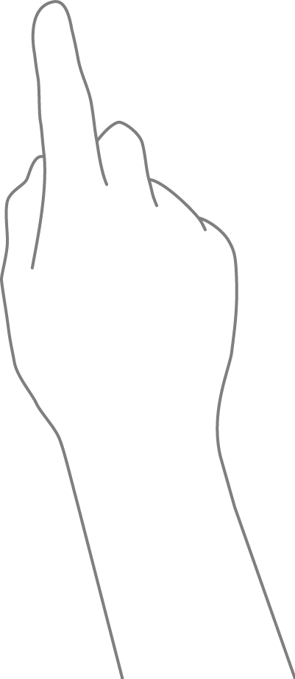
Event Models
MSPointerDown
MSPointerMove
MSPointerUp
MSPointerOver
MSPointerOut
MSPointerCancel
MSPointerHover
Pointer
But not
as a
crutch!
Supports multipoint inputs
captures touch, click, pen
Individual Event Objects
Notes:
New Pointer Model proposed by MS with ie10 and windows 8 app
Look for

Slide 2
Event Models
Event object for pointer
event
clientx
clienty
target
preventDefault
etc
event
clientx
clienty
target
preventDefault
etc
event
clientx
clienty
target
preventDefault
etc
Notes:
A touch event object is constructed much different than a click object.
Traditional attributes like event.target or event.x may give you false responces as it will only be associated with one touchpoint
True touch points are nested in these three arrays

Slide 3
Event Models
Additional values on pointer objects
width
height
pressure (pen)
tilt(pen)
rotation
pointerType
pointerId
Event type
Any more!
Notes:
Similar object formation to traditional event object, all same values in pointer event object but with more
Provides additional information

Slide 4
Touch First
if (window.ontouchstart) {
myButton.addEventListener('touchstart', myFavFunction, false);
}
else {
myButton.addEventListener('click', myFavFunction, false);
}
Change this to … this
if (window.navigator.msPointerEnabled) {
myButton.addEventListener('MSPointerDown', myFavFunction, false);
} else if ('ontouchstart' in document.documentElement) {
myButton.addEventListener('touchstart', myFavFunction, false);
}
else {
myButton.addEventListener('click', myFavFunction, false);
}
Notes:
So now lets upgrade our feature detection to consider pointers as well

